Slide 1

Visualizing Geospatial Data

Slide 2
Objectives
Explain how to use the Folium, for visualizing geospatial data.
Use Folium to create maps and superpose markers.
Create Choropleth Maps with Folium.
Visualization Geospatial Data

Slide 3
Introduction to Folium
What is Folium?
  Folium is a powerful data visualization library in Python that was built primarily to help people visualize geospatial data.
Create a map of any location in the world as long as you know its latitude and longitude values.
Create a map and superimpose markers as well as clusters of markers on top of the map for cool and very interesting visualizations.
Create maps of different styles such as street level maps, stamen map
Visualization Geospatial Data

Slide 4
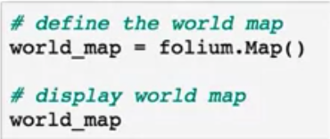
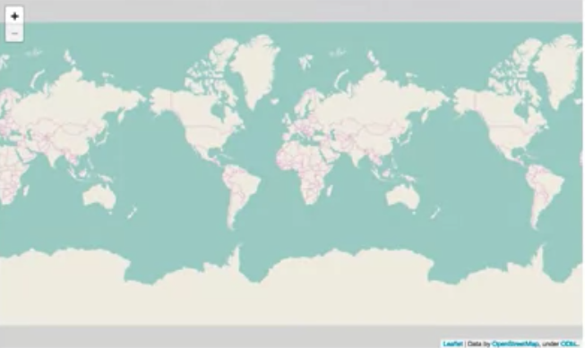
Introduction to Folium
Folium is that they are interactive, so you can zoom in and out after the map is rendered
Visualization Geospatial Data

Slide 5
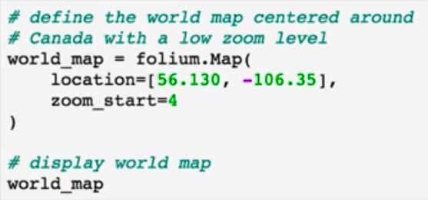
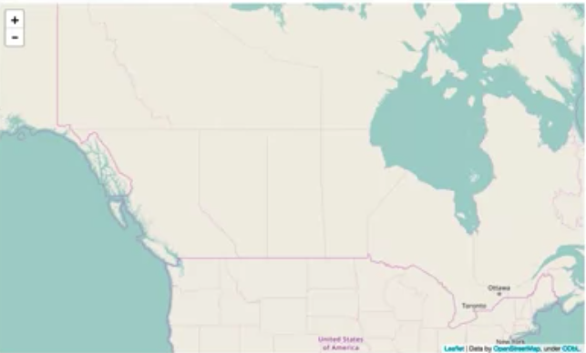
Introduction to Folium
Try this code and show the results
Task: show map of
FPT University
Visualization Geospatial Data

Slide 6
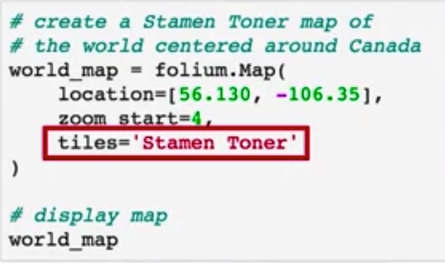
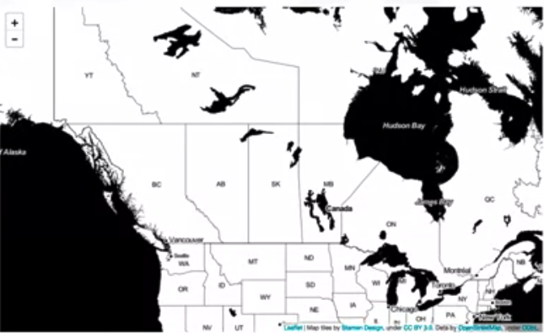
Introduction to Folium
Try this code and show the results
Task: show map of
FPT University
Visualization Geospatial Data

Slide 7
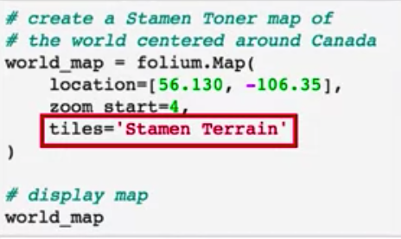
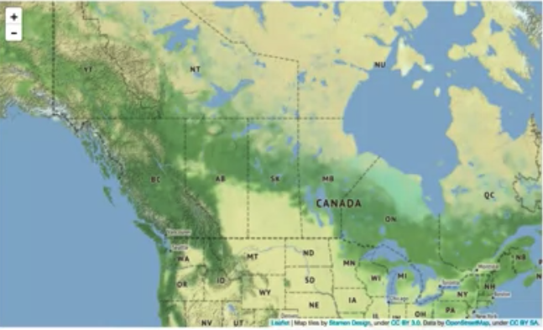
Introduction to Folium
Try this code and show the results
Task: show map of
FPT University
Visualization Geospatial Data

Slide 8
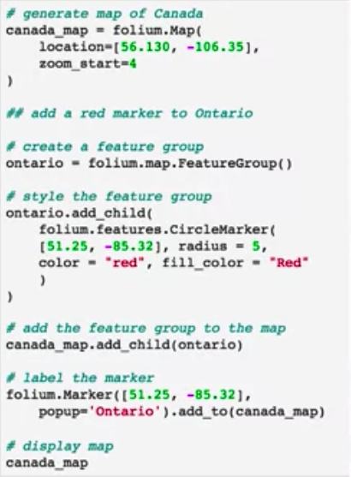
Maps with Markers
Try this code and show the results
Task: show the map of your home with marker “sweet home”
Visualization Geospatial Data

Slide 9
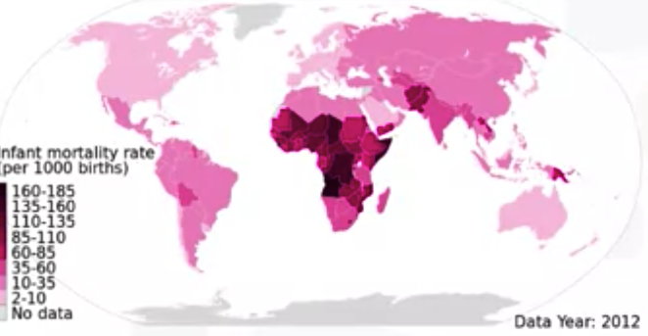
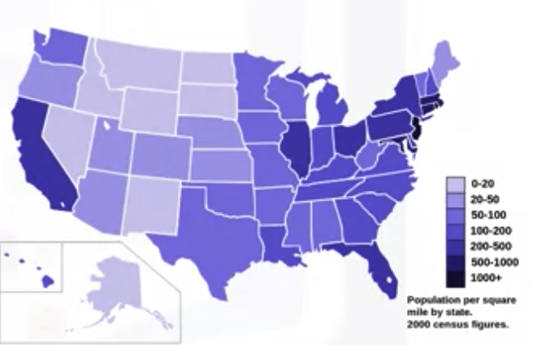
Choropleth Maps
What is a choropleth map?
Student give the opinions!
Visualization Geospatial Data
Notes:
the map to the left is a choropleth map of the world showing infant mortality rate per 1000 births.
the map to the right is a choropleth map of the US showing population per square mile by state

Slide 10
Choropleth Maps
What is a choropleth map?
  A choropleth map is a thematic map in which areas are shaded or patterned in proportion to the measurement of the statistical variable being displayed on the map, such as population density or per capita income.
  The higher the measurement the darker the color.
Top create a choropleth map we need Geo JSON file:
  It includes geospatial data of the region.
  Map of the world: Geo JSON file that lists each country along with any geospatial data to define its borders and boundaries.
Visualization Geospatial Data

Slide 11
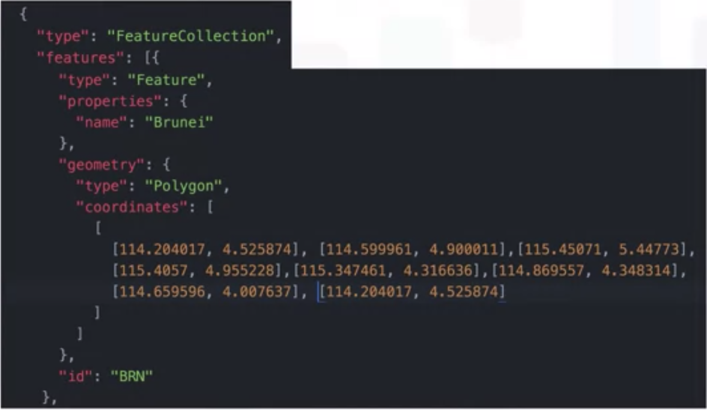
Choropleth Maps
The Geo JSON file of Brunei
Visualization Geospatial Data
Notes:
Link file:

Slide 12
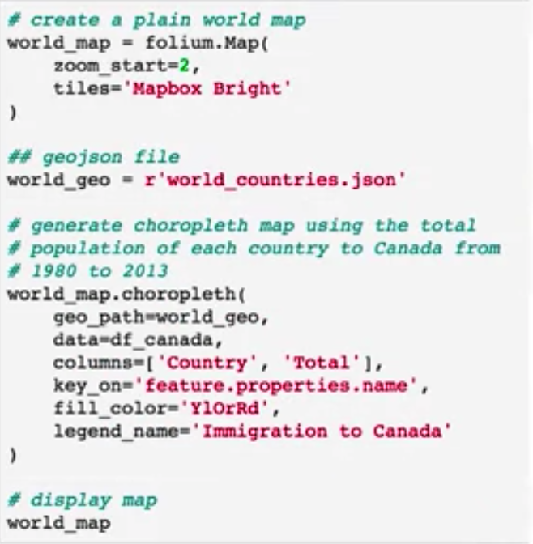
Choropleth Maps
Try this code and show the results
Visualization Geospatial Data
Notes:
Using immigrants dataset

Slide 13
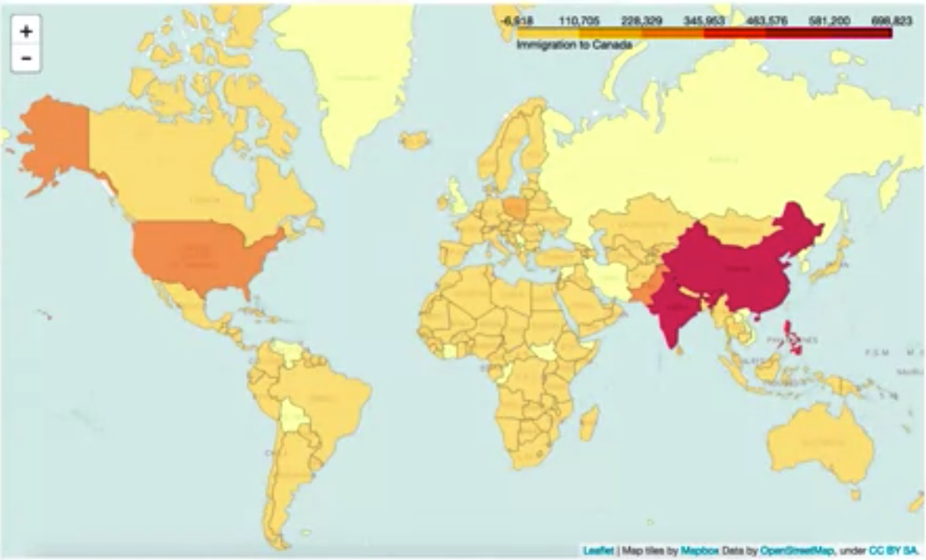
Choropleth Maps
Visualization Geospatial Data

Slide 14
Summary
Explain how to use the Folium, for visualizing geospatial data.
Use Folium to create maps and superpose markers.
Create Choropleth Maps with Folium.
Visualization Geospatial Data

Slide 15
Q & A
Visualization Geospatial Data

